Slide 1
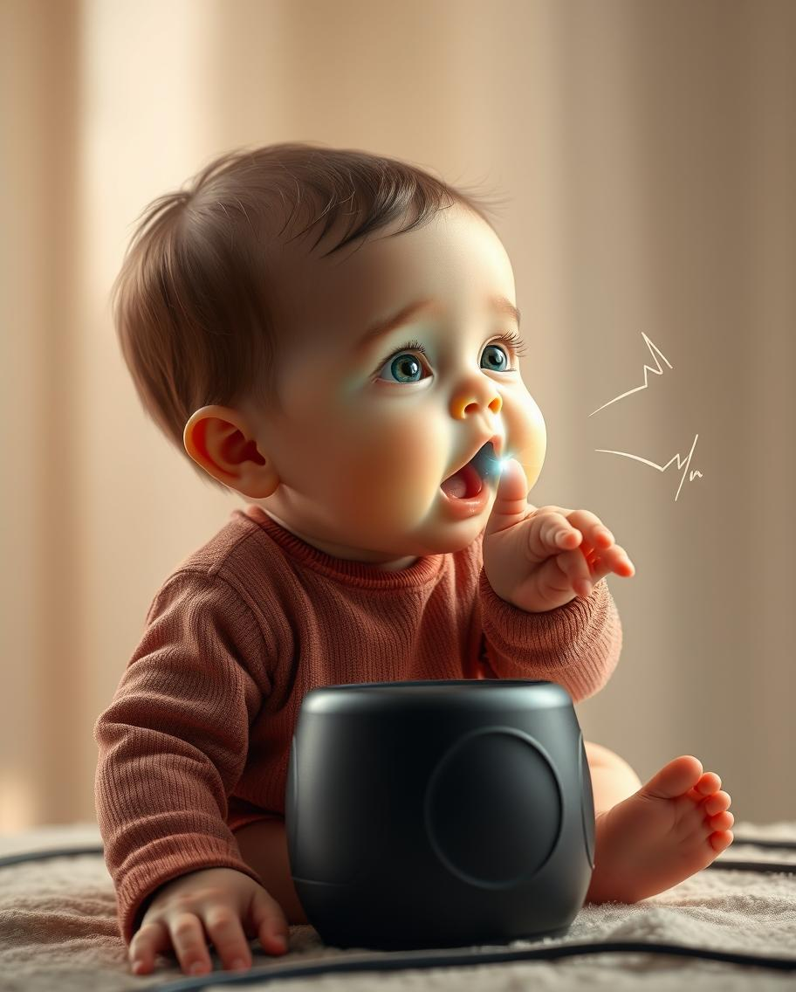
BABY MONITERING DEVICE

Slide 2
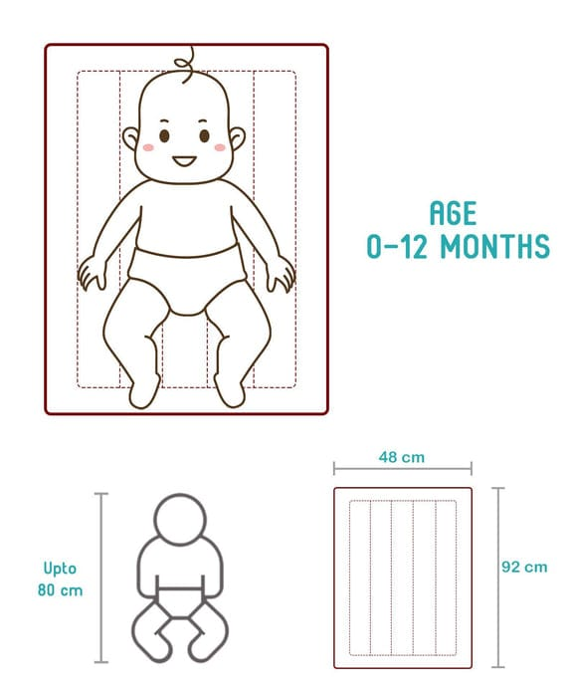
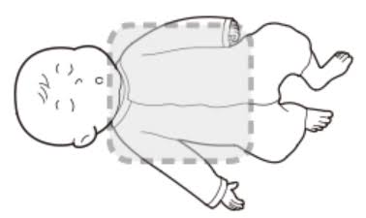
SENSING MAT SURFACE
NOT COMFORTABLE SURFACE
COMFORTABLE SURFACE

Slide 3




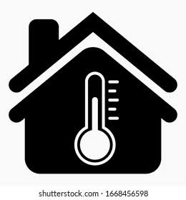


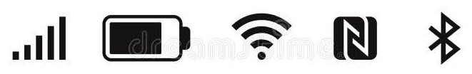


FEATURES
Components
Mic(Microphone)
Speaker
Oxygen sensor
Room temperature sensor
Weight sensor
Ventilation fan
IOT(Bluetooth,wifi,GSM)
Application
Camera

Slide 4
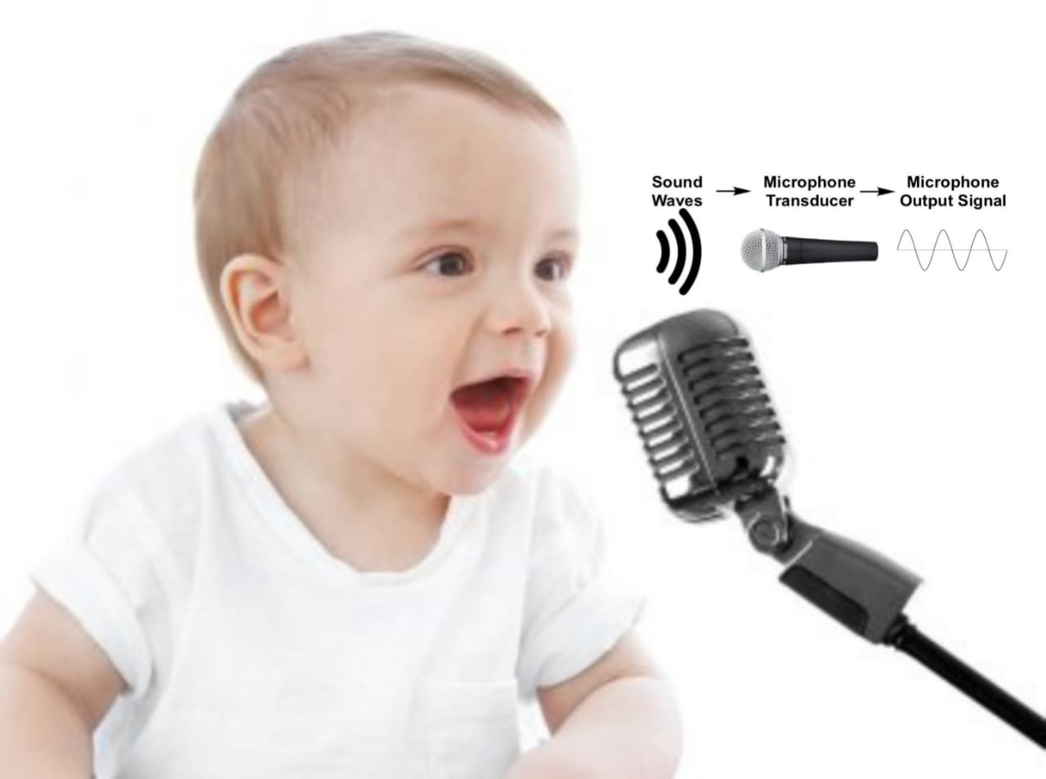
MIC (Microphone)
Continuous Monitoring:
Monitors the baby’s sounds at all times.
Cry Detection:
Detects when the baby is crying and sends feedback to the application.
Persistent Cry Alert:
If crying continues, it alerts the parents via phone and generates a warning sound.

Slide 5
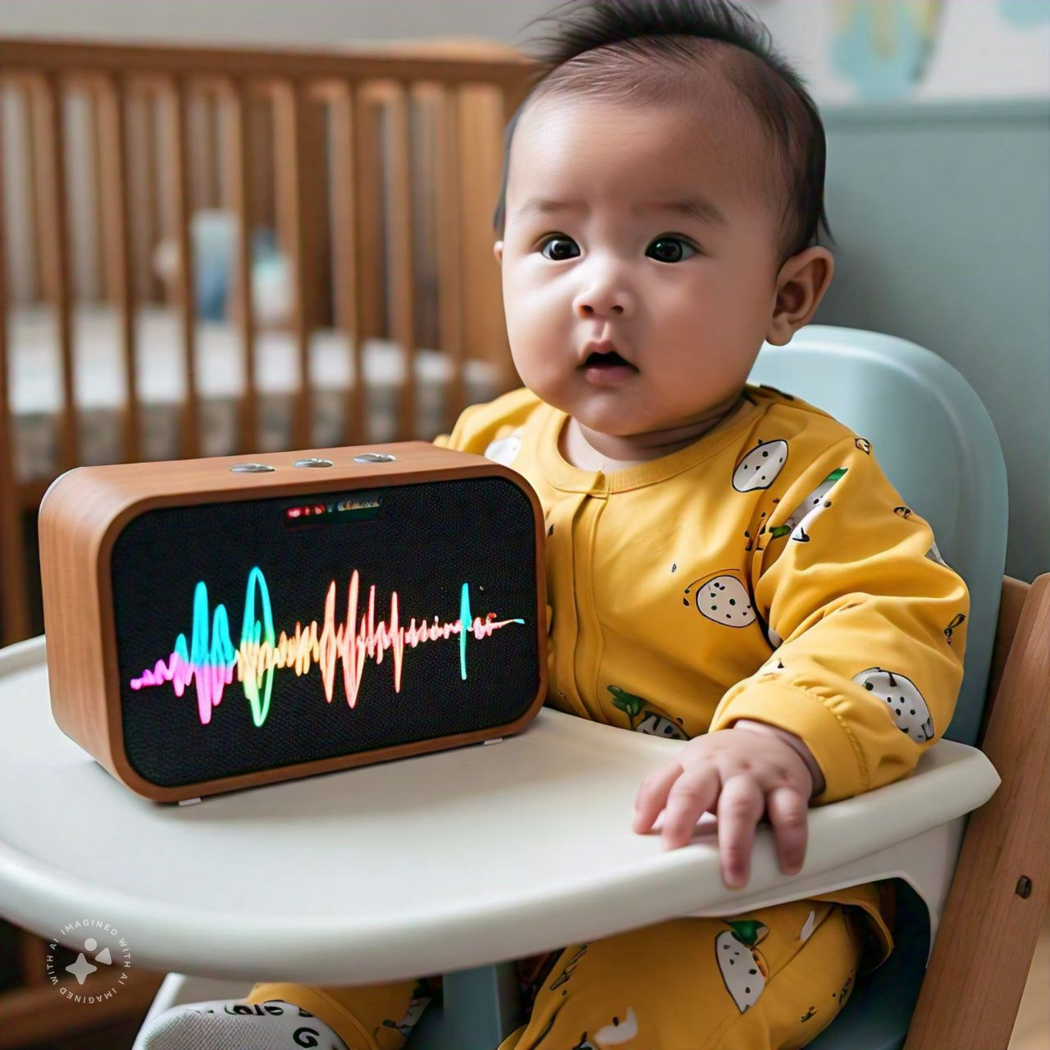
SPEAKER
Direct Communication:
Allows parents to speak directly to the baby through the phone and the Baby Smile module.
Alerts:
Generates warning sounds to indicate to the parents that the baby needs attention.
Smoothing Sounds:
Plays smoothing melodies and natural sounds to comfort the baby

Slide 6
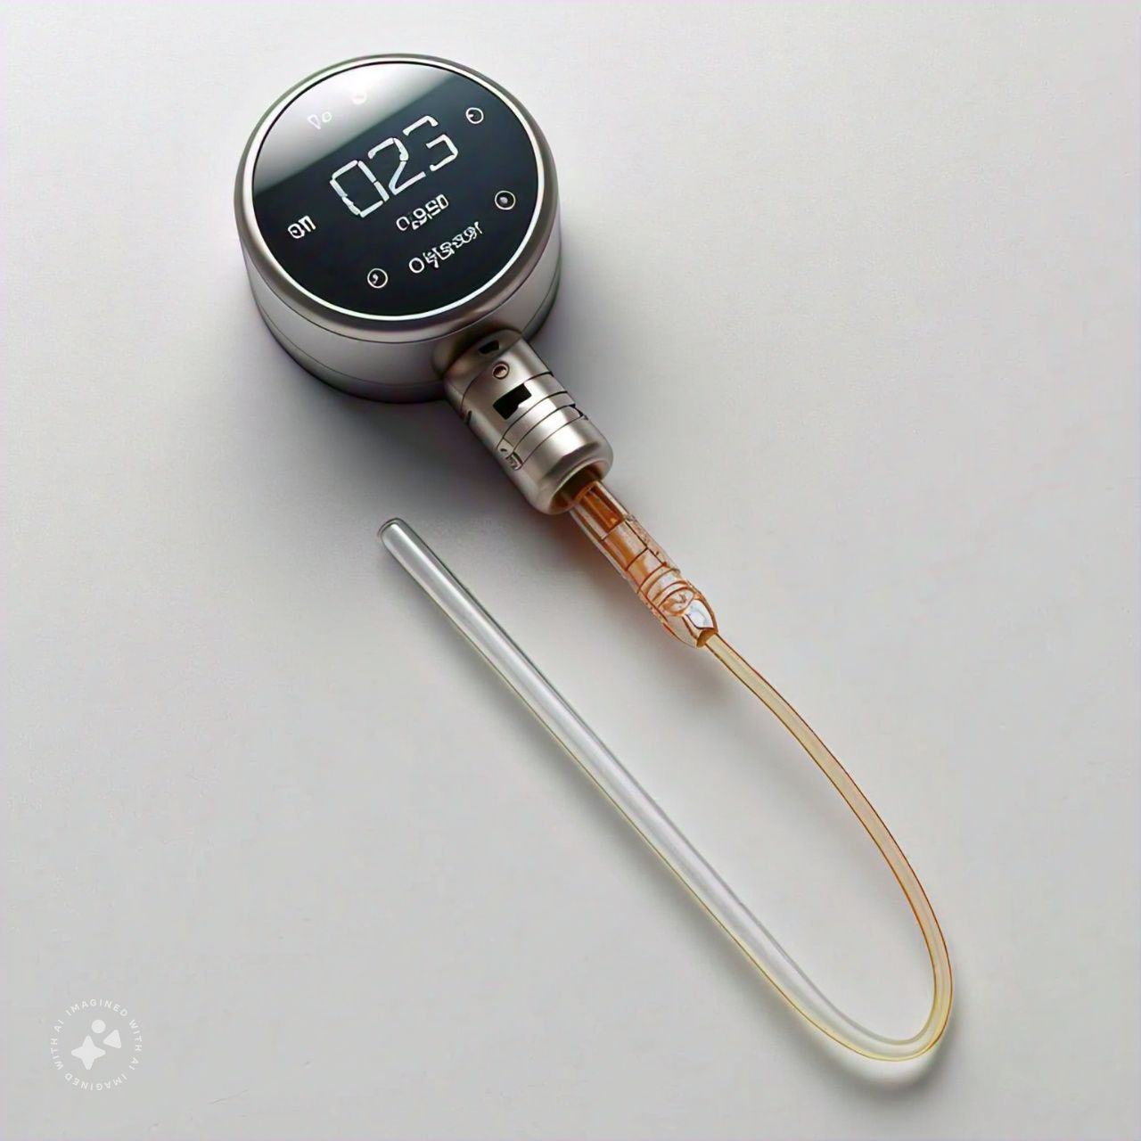
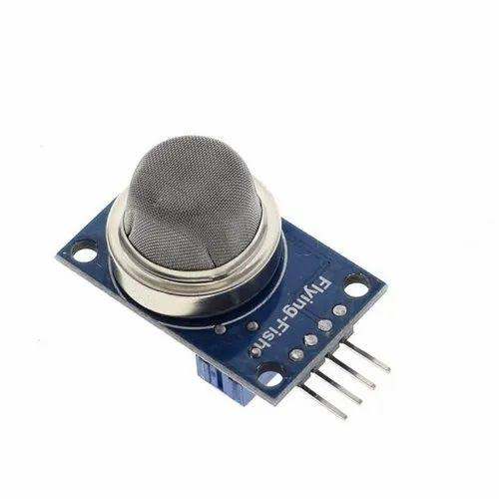
OXYGEN SENSOR
Continuous Monitoring:
Tracks oxygen levels, CO2 levels, and harmful gases in the environment.
Real-Time Feedback:
Sends continuous updates to the application about the gas levels and environment status.
Alerts:
Generates a warning sound and notifies the parents via phone if any issues are detected.
Application Status Update:
Provides detailed information on CO2 and O2 levels, as well as any harmful gases detected.

Slide 7
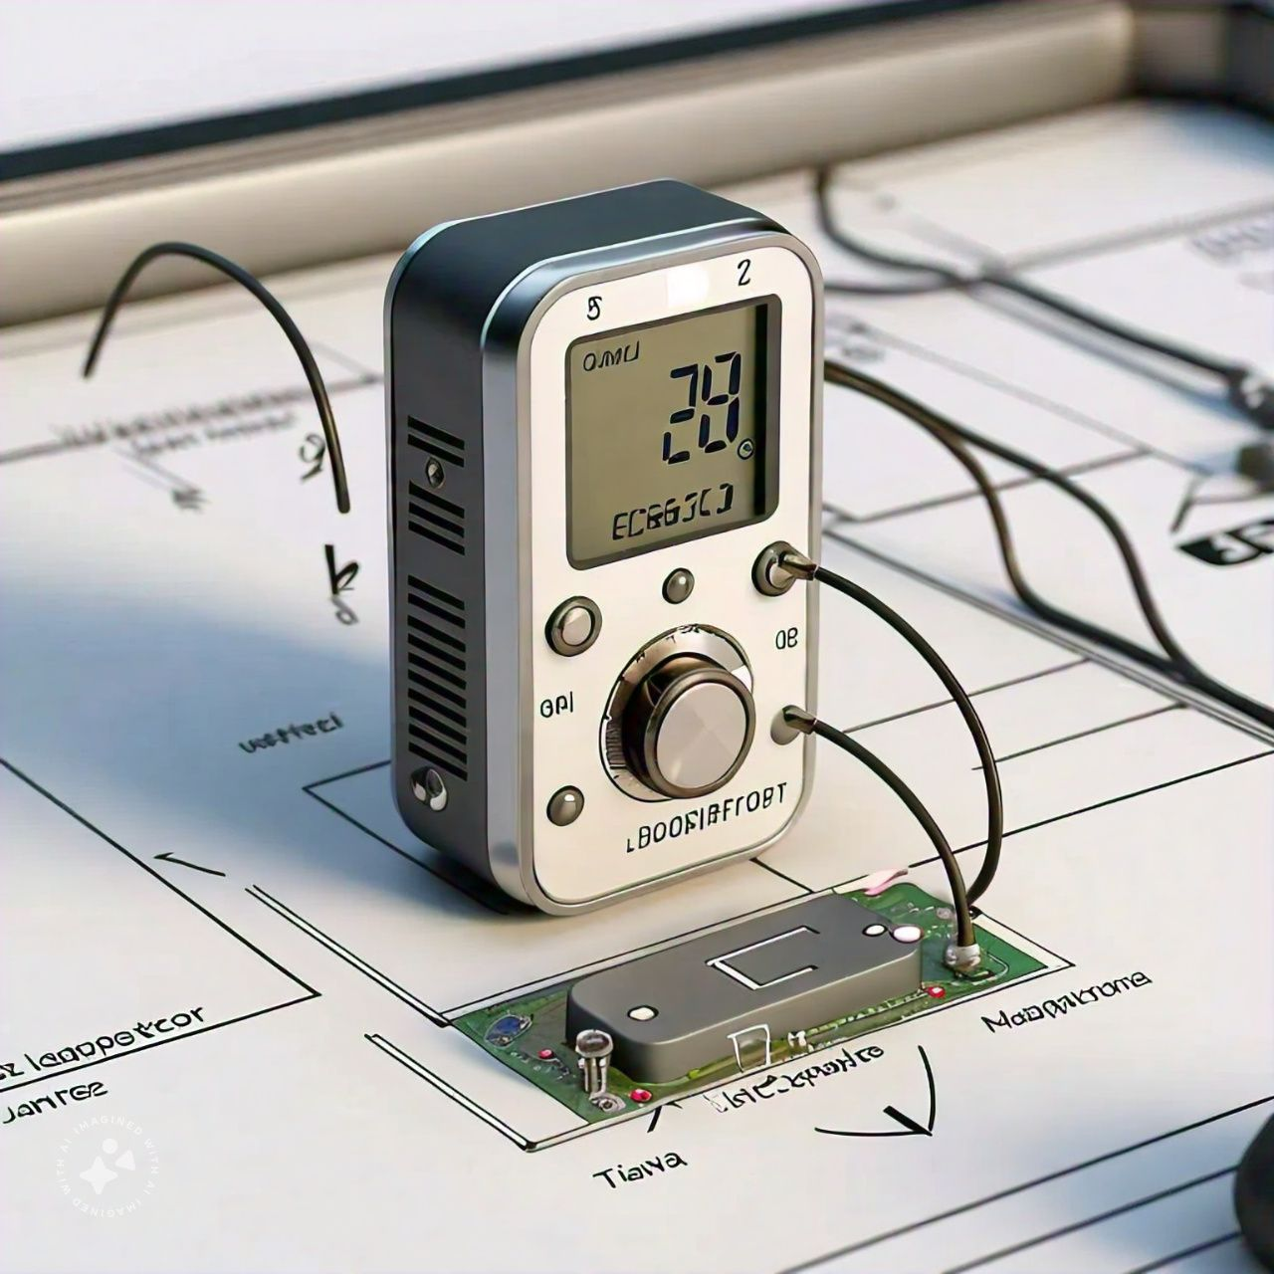
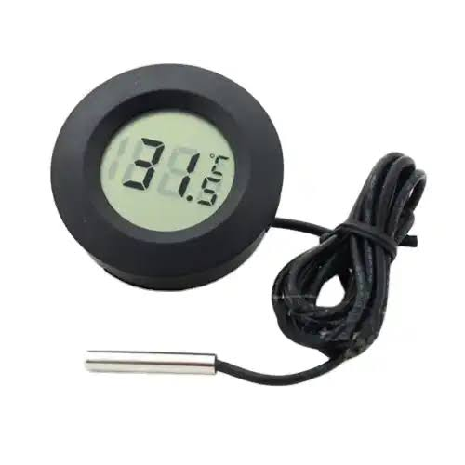
ROOM TEMPERATURE SENSOR
Continuous Monitoring:
Continuously tracks the room temperature and updates the application.
Automatic Fan Control:
Activates the fan automatically if the room temperature rises.
Temperature Limit Alert:
If the temperature exceeds the maximum and Minimum limit despite the fan running, the sensor alerts the parents via phone and generates a warning sound.

Slide 8
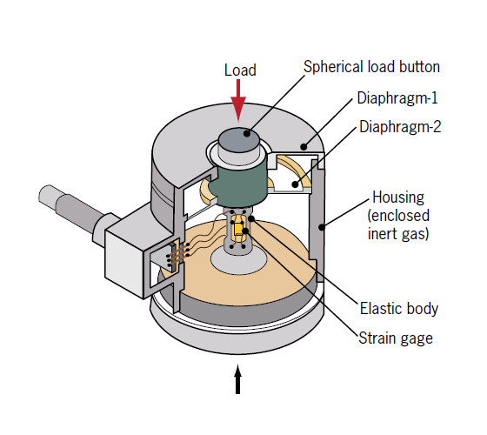
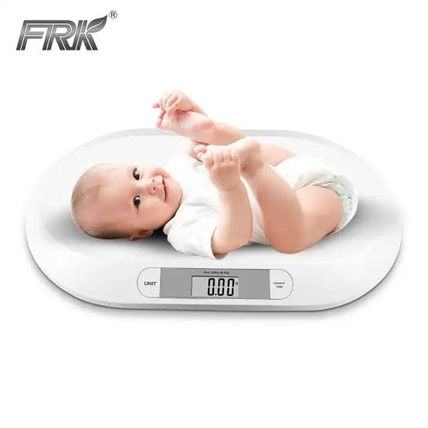
WEIGHT SENSOR
Continuous Monitoring:
Tracks the baby’s weight continuously and updates the application.
Daily Weight Tracking:
Records weight data daily to monitor the baby's health and generate a weight graph in the app.
Movement Detection:
Detects if the baby is moving or stationary.
Alerts the parents via phone and generates an alarm if the baby is moving.

Slide 9
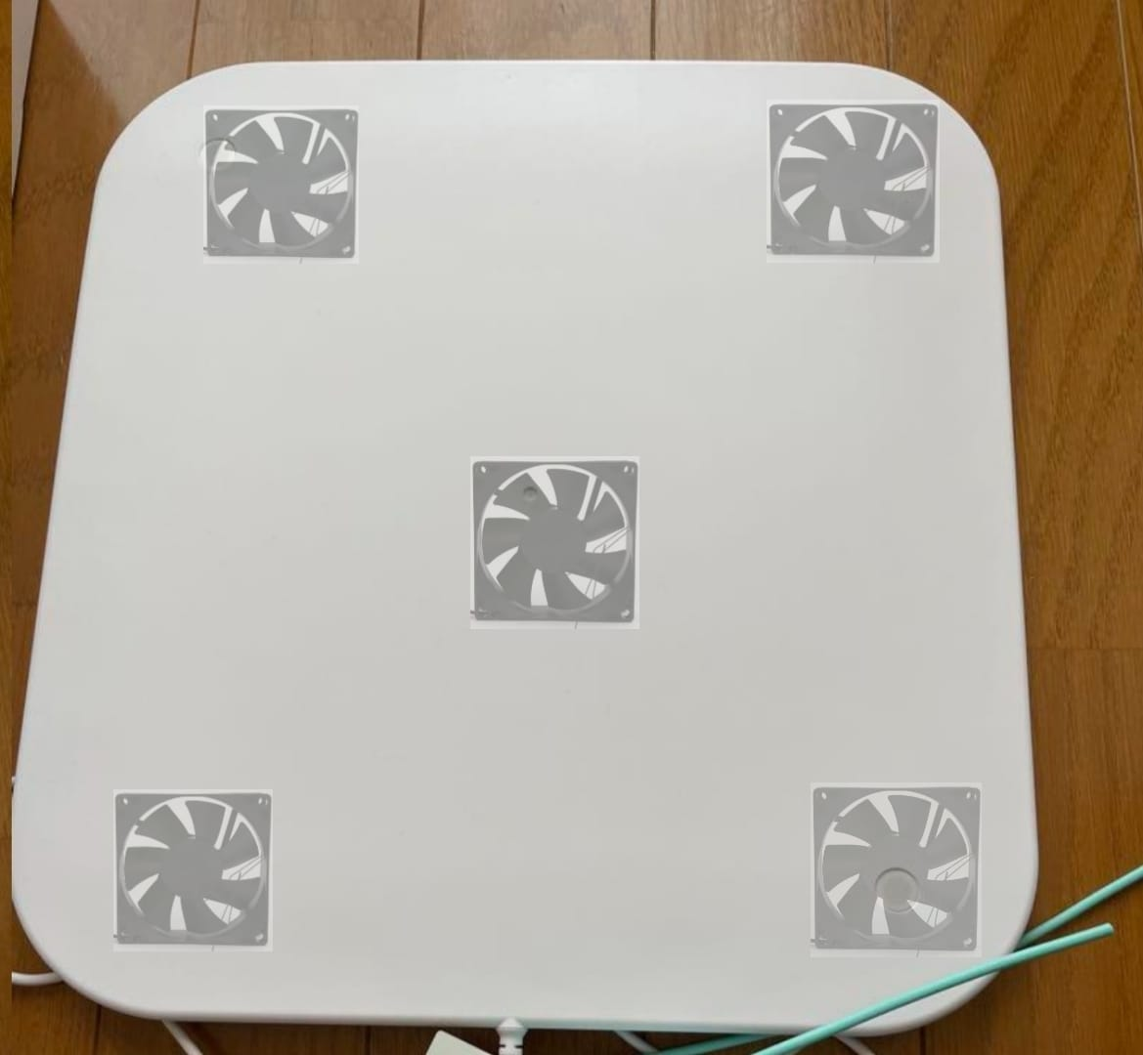
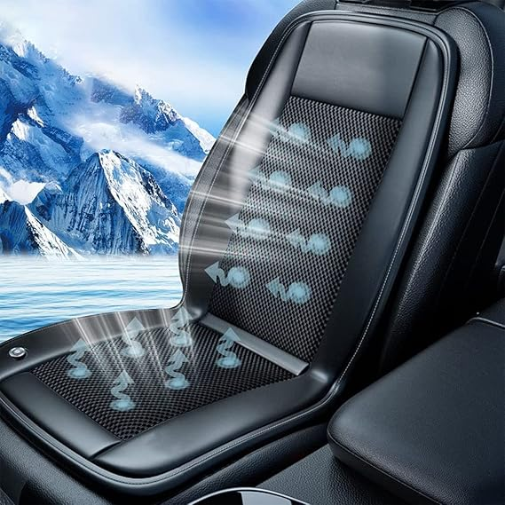
VENTILATION FAN
Temperature Regulation:
Helps maintain the baby’s body temperature.
Automatic Operation:
Turns on automatically if the baby feels warm or sweaty.
Temperature-Driven Control:
Stops automatically if the room temperature becomes too low.
SIMILAR TO SEAT VENTILATION SYSTEM

Slide 10



IOT (Bluetooth, WiFi, or GSM)
Data Transmission:
Transmits data from the Baby Smile module to the application using one of the following modules:Bluetooth, WiFi, or GSM.
Module Selection:
The module used (Bluetooth, WiFi, or GSM) depends on the specific requirements and availability.
IoT Concept:
Implements the IoT concept to enable efficient and reliable data communication.

Slide 11
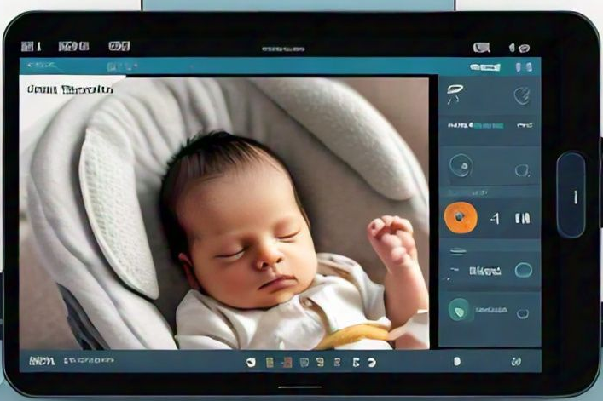
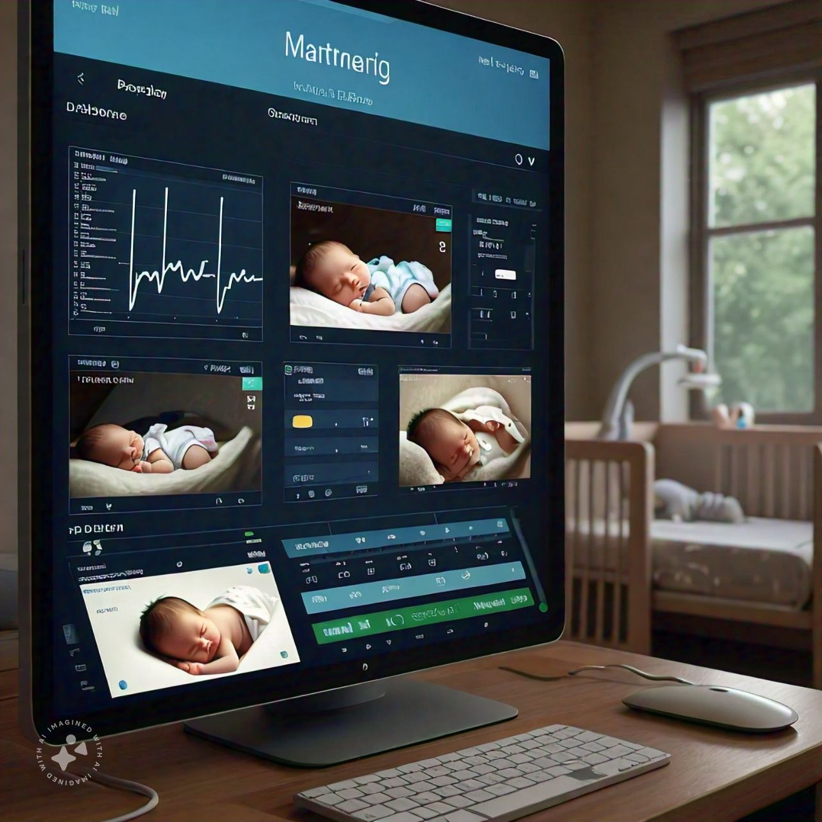
APPLICATION
Data Monitoring:
Monitors and displays all data received from the Baby Smile module.
Parental Controls:
Enables parents to manually control the fan speed.
Allows parents to play music for the baby.
Live Interaction:
Facilitates live conversations with the baby through the app.

Slide 12
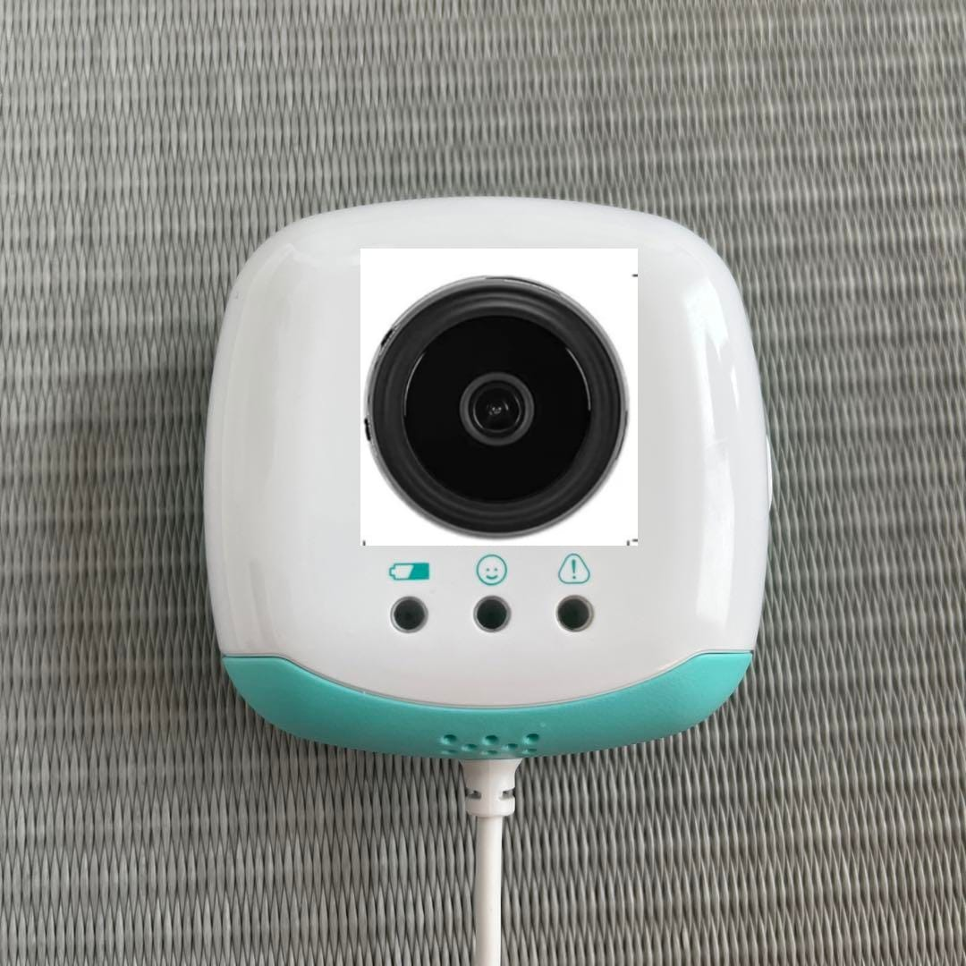
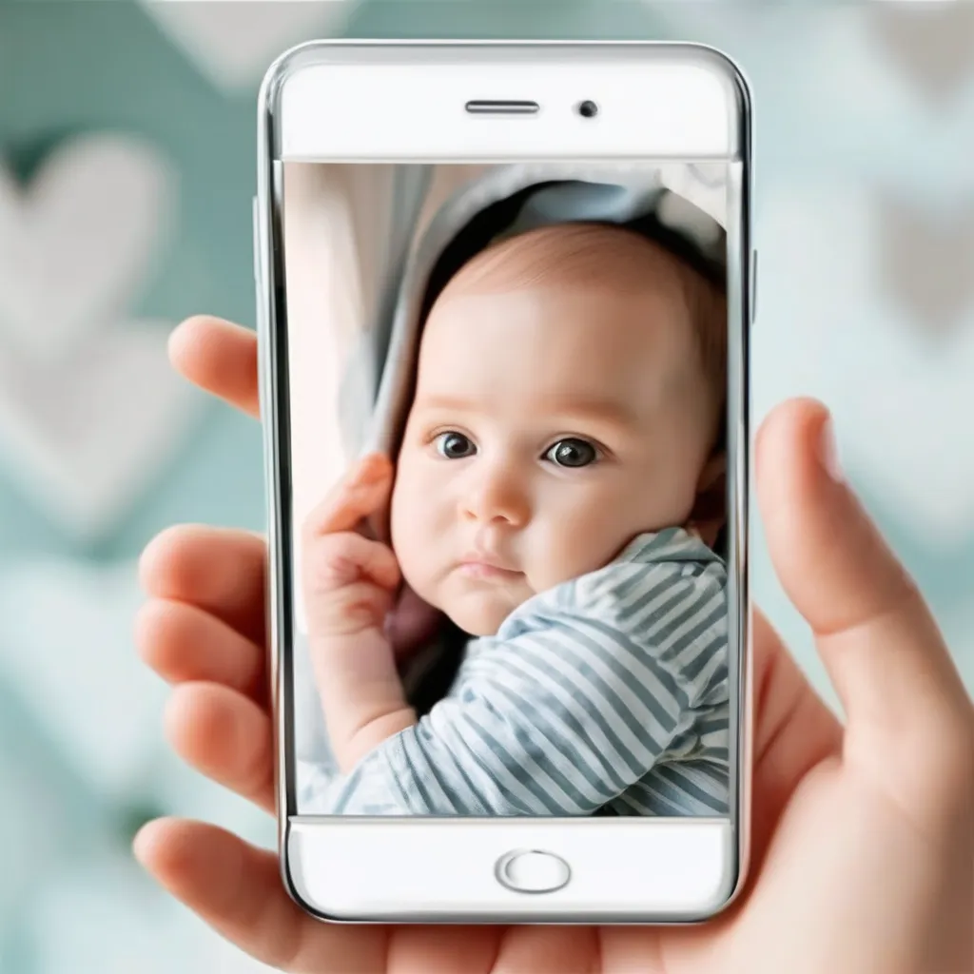
CAMERA
DataSaving:
Some memorable moments video data save memory (eg:baby first pronunciation word videochip stored in memory)
Parent Live Interaction:
Cameras in baby monitors allow parents to watch live footage of their baby in real-time. This enables them to check on their baby's activities, sleeping patterns, and general well-being from another room or even remotely via a smartphone app.

Slide 13
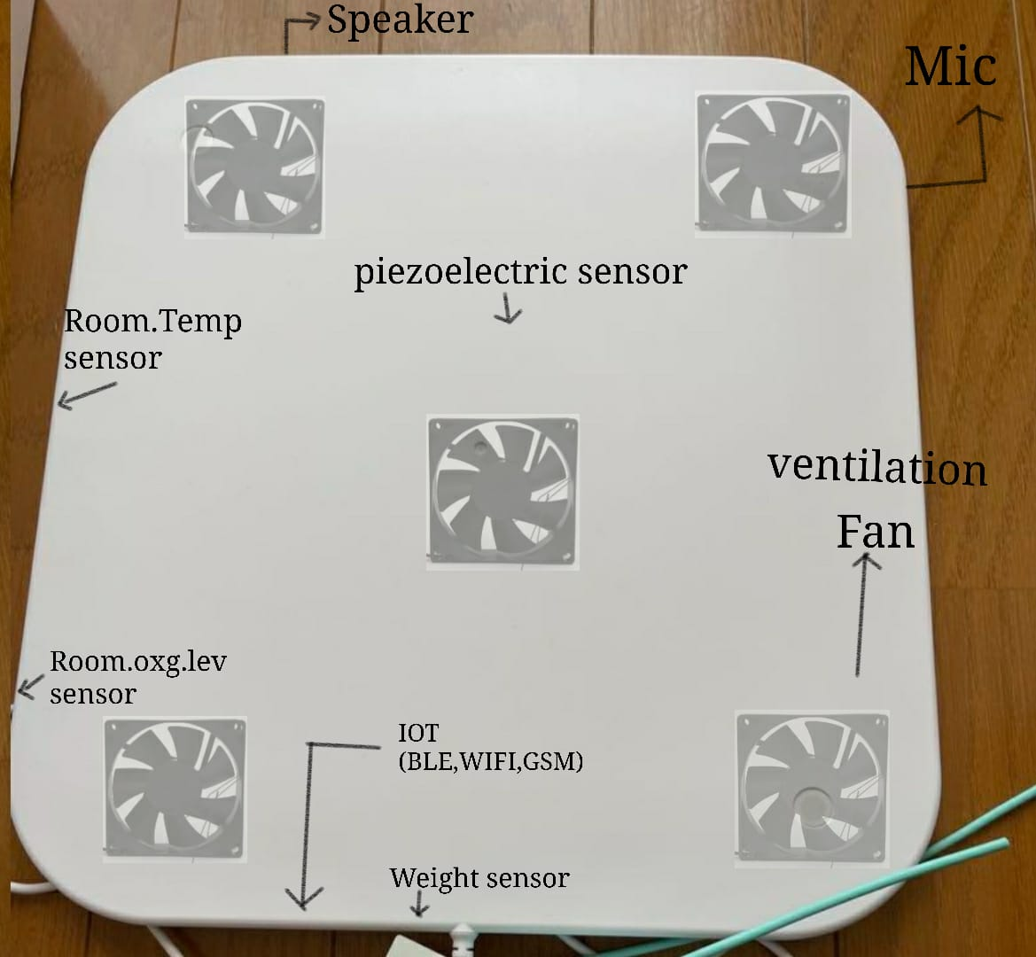
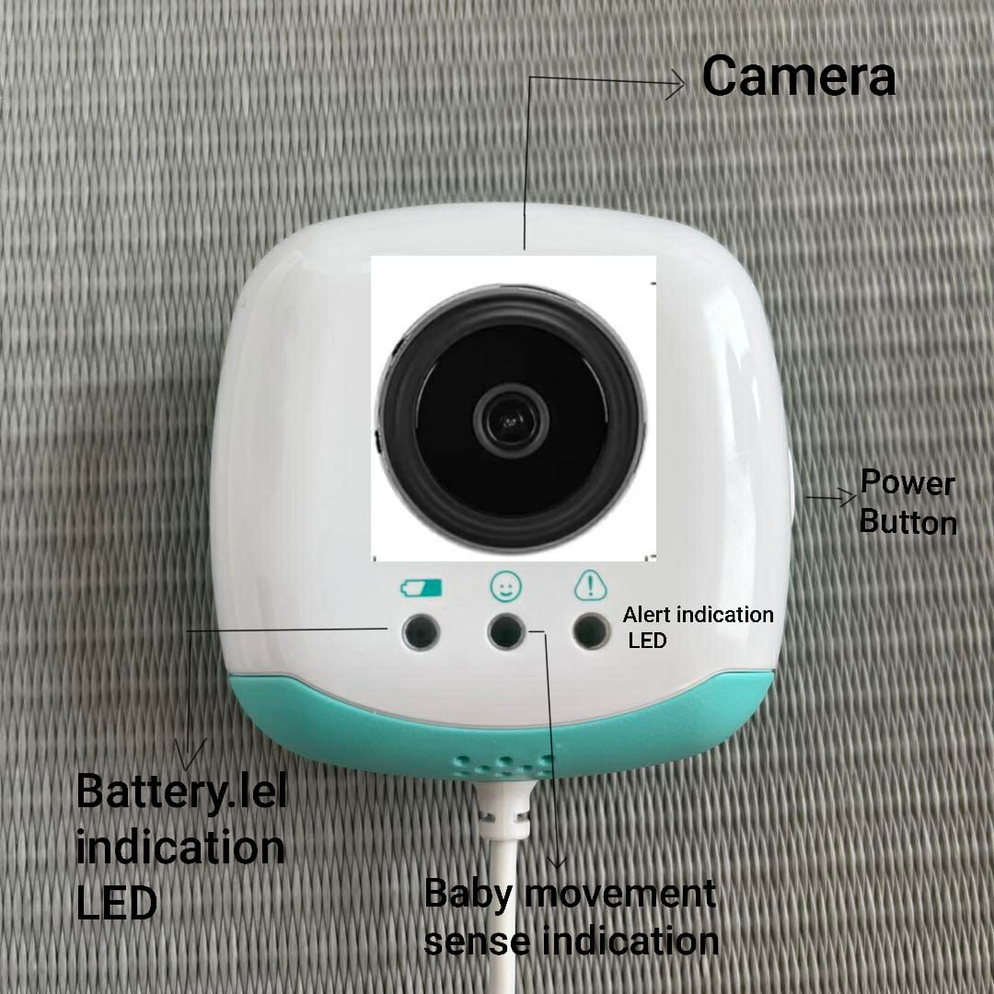
FINAL

Slide 14
THANK YOU

